Slide 1
Intergenational transfers in Spain in the long-run (1960-2012)
Alfonso Herranz-Loncán (University of Barcelona)
Guadalupe Souto-Nieves (Autonomous University of Barcelona)
Sergio Espuelas Barroso (University of Barcelona)
Gemma Abio (University of Barcelona)
Concepció Patxot-Cardoner (University of Barcelona)

Slide 2
Data
First HBS in Spain was carried out in 1958, but very poor data for NTA (addressed to know the consumption patterns of the average Spanish household, hence not representative of the whole population).
HBS was carried out again in 1964 and 1973, with a better sample design and much more information. Unfortunately, microdata are missing.
HBS design was significantly improved in 1980 and 1990, and adapted to EEC recommendations. Microdata of these two waves was digitized by Universidad Carlos III and is now available for researchers.
Important to have into account polítical changes in Spain after 1975 (end of the dictatorship and starting of profunds changes in socioeconomic structures along the eighties).

Slide 3
This paper:
Approaches the changes in the system of intergenerational flows in Spain in the long-term, for the period for which HBS are available (estimates so far for 1980, 1990) and compared to results for 2000 and 2012
Discusses if historical statistics and informed assumptions can be the basis for NTA estimates for periods before the earliest HBS (very preliminary estimate for 1960) → would allow observing the impact of the whole process of construction of the welfare state and the whole demographic transition.

Slide 4
Important
Political changes in Spain after 1975: end of the dictatorship and starting of profunds changes in socioeconomic structures along the eighties

Slide 5
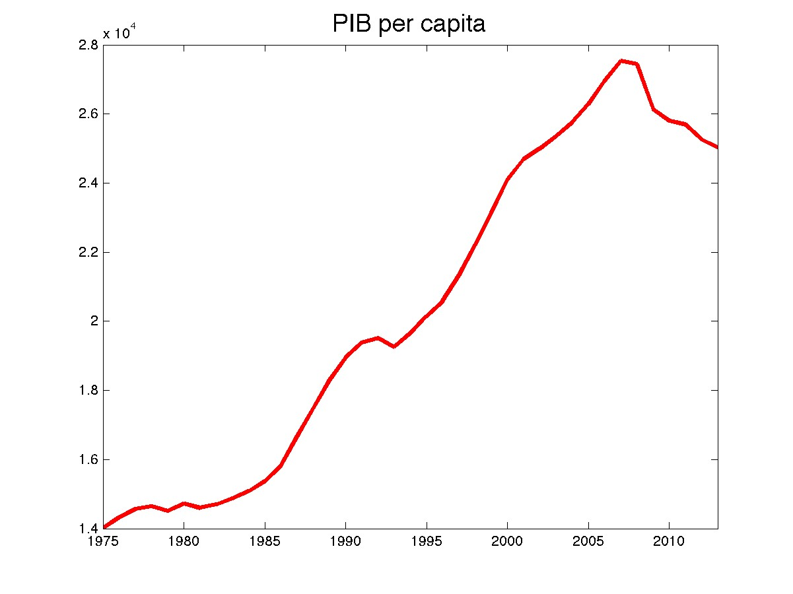
GDP per capita ($ of 2005)

Slide 6
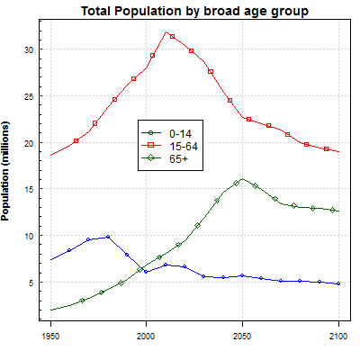
Spain
Notes:
El mundo está viviendo un profundo cambio en la estructura por edades de la población. Si bien la transición demográfica está teniendo lugar a diferentes ritmos según los países, el envejecimiento es un fenómeno global. Cabe mencionar que España es uno de los países que se enfrenta a una transición demográfica más acentuada debido a varios factores (una de las esperanzas de vida más altas del mundo junto con una de las tasas de fecundidad más bajas; a ello se puede añadir el baby-bust post-Guerra civil y el baby boom finales de los 50-finales 70, que configuran una pirámide con ciertas características algo diferentes al resto de países europeos.

Slide 7
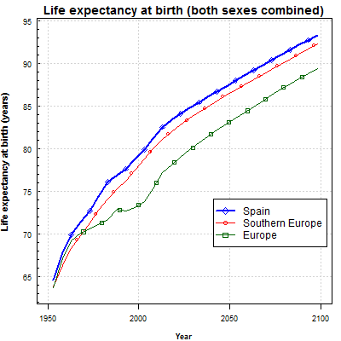
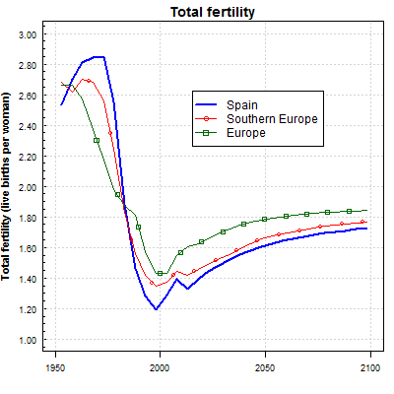

Slide 8
1970
33.9M
1980
37.7M
1990
39.2M
2020
46.8M
2050
43.6M
2000
40.8M

Slide 9
HBS-based NTA estimates for Spain
Spanish HBS: 1958, 1964, 1973-74, 1980-81, 1990-91 and continuous HBS since 1997:
Sufficient coverage only since 1964.
Microdata available only since 1973-74.
Sufficient individual information only since 1980-81.
⇒ The standard NTA methodology can only be applied since 1980-81.

Slide 10
Per capita labor income (euros 2012)
No significant changes for younger workers’ labor income until 2012.
Labour income increases remarkably for workers aged 30-55 between 1980-2000.
In 2012 the effects of the Great recession are evident (older workers are much less affected).

Slide 11
Per capita total consumption (euros 2012)
Change in the age profile’s shape: more consumption of the elderly, especially with the Great Recession

Slide 12
Significant increase of the public consumption on the both extremes of the lifecycle (education and health, respectively).
Increases in private consumption are very low for the young, and more important for the elderly, particularly in 2012 (with the Great Recession)

Slide 13
Per capita Life Cycle Deficit (euros 2012)
Significant increase of the LCD, both for the young and the elderly.
Surplus increased, but reduced with the Great Recession (and the age range moved to the right)

Slide 14
The financing sources of LCD (euros 2012)
TG (net)
Significant increase for the young and, particularly, for the elderly (2012!)
At once, increase of taxes and social contributions for working ages (stopped with the Great Recession)

Slide 15
The financing sources of LCD (euros 2012)
TG
TF
Strong increase of TF for ages 15-25 (high education)

Slide 16
NTA for the pre-HBS period?
Data available in several sources (early –incomplete- HBS, population censuses, government education and health surveys, etc.).
Need to increase the number of assumptions (specially on the age distribution of labour income and consumption).
Difficulty to estimate ABR and TF.
→ Still research in progress.

Slide 17
Life cycle deficit and its components, per capita, 1960-2012 (euros 2012)

Slide 18
Main findings
Gradual increase in the importance of government transfers as reallocation mechanism (welfare state’s consolidation)
Gradual increase of the importance of the elderly in the size of total reallocations.
Government transfer bias towards sustaining the elderly’s income (poverty risk tends to be concentrated in families with dependent children).

Slide 19
People at risk of poverty or social exclusion by age in Spain
Picture in 2018 is completely different from 2005: the young have been particularly affected by the Great Recession.
Source: Eurostat, 2020

Slide 20
People at risk of poverty by type of household in Spain
Careful!!!
Poverty tends to concentrate in households with children along the last decade:
It is time to re-think the reallocation system and, particularly, the welfare state
Source: Eurostat, 2020

